Slide 1
Eliminating the Headache of Global Safety Reporting
Steven Beales
SVP, Safety Solutions

Slide 2

Webinar Agenda
Introduction of Today’s Speaker
20 Minute Presentation
Eliminating the Headache of Global Safety Reporting
Q&A
Closing & Follow-Up

Slide 3
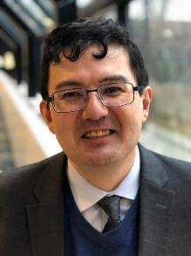
Meet Today’s Speaker
Steven Beales
Current SVP, Safety Solutions for WCG
Led design & implementation of SafetyPortal at multiple organizations
25+ Years Experience in Pharma & IT Industry

Slide 4
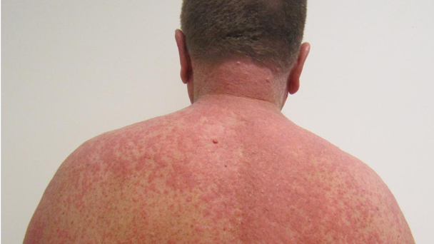
Every 30 seconds
Notes:
In the next 30 seconds, someone will be admitted to hospital in US suffering from a serious adverse drug reaction. ADRs make up 6.5% of all patient admissions, over 1m admissions per year, not including 400-500k within hospital ADEs.

Slide 5


Every 10 mins
Notes:
It is a shock to realize that by the time we finish this talk, 2 people in the US will have had fatal drug reactions. 1 child will have had a life threatening drug reaction. Statistically, 1 of us listening to this webinar will end up in hospital from an adverse reaction this year.

Slide 6
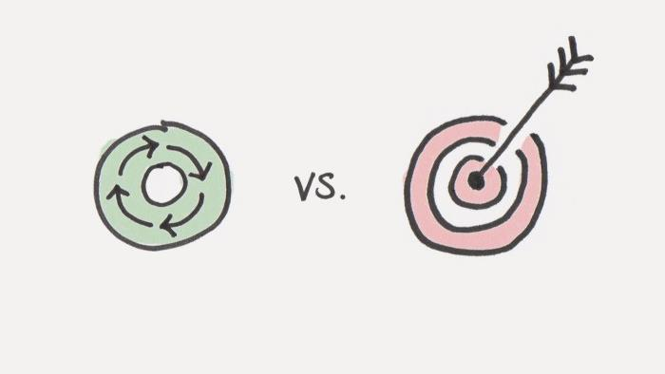
Who Suffers?
Who Profits?
Notes:
If we want to understand why something bad is happening in America, we need to focus on who profits from that problem, not who suffers from the problem.

Slide 7
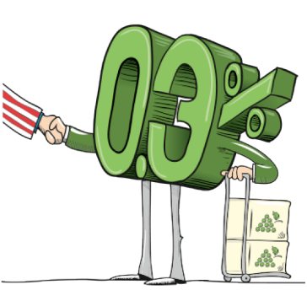
Post-marketing
PV
Sales
Notes:
From 2003-2017, 0.3% of sales was spent on post market pharmacovigilance – for comparison purposes, less than the 0.5% share of popular vote Evan McMullin, the independent Mormon from Utah, won in the 2016 Presidential election.
We, as Drug Safety professionals are under ever increasing pressure to do more with less.

Slide 8
900k Potential AEs
373k
AR
100k
SAR
10k SUSAR
1.2m
RA
Greatest cost
25m
Site/EC
Notes:
Let’s examine a top 3 pharma’s drug safety funnel. Where is the greatest cost and effort expended? It’s where the least attention is paid – distributing to investigators and ethics committees. 900k potential AEs, 373k ARs, 100k SARs, 10k SUSARS, 1.2 M RA reports, 25m Safety Letters.

Slide 9

Review Your Contracts
# 1
Notes:
Call to Action 1 - review your safety distribution costs in your contracts.
You will be stunned at the inconsistency. Sometimes costs are per site, sometimes per safety letter, sometimes flat fee.
Across different trials on same compound the costs will be different even with same provider.

Slide 10

Cash Cow
Notes:
You may well uncover a cash cow in disguise.
The largest cost I’ve seen on 1 trial for Safety Reporting is $7.8m for a 4 year trial.
Clinical trials safety reporting costs are often hidden in other budget line items, so we don’t know what the real cost is.

Slide 11
Centralize Safety Reporting
# 2
Compound Level
Notes:
Call to Action 2 - Centralize safety reporting within your organization to eliminate over-spend. Safety Reporting is a compound level activity that belongs in drug safety not clinical operations because of cross reporting.

Slide 12

Inside every single one of us we have the most powerful device known to humankind
Notes:
This is our current reality …
Inside every single one of us, we have the most powerful device known to humankind
And that's an idea.

Slide 13




Right Information
Right Time
Right Person
Notes:
Our idea was to build a universal safety transporter. Imagine saying “Computer, “beam” my safety information to the right person at the right time anywhere in the world.
We were a couple of centuries early for star trek so we had to build the platform ourselves.
It has taken us more than 7 years.

Slide 14
2 Top 3 Sponsors
Top 3 CRO
2 Top 3 IRBs
Top 3 Biotech
Precision Safety Reporting
Notes:
An idea is powerless if it is communicated and doesn’t resonate.
2 of the top 3 Sponsors, 1 of top 3 CROs, 1 of top 3 biotech and 2 of top 3 IRBs understood the economic, safety and compliance reasons to embrace the future and implement precision safety reporting – getting the right information to the right person at the right time anywhere in the world according to local laws. Our first task was to assemble all the different country legislation so we could build a rules-based artificial intelligence. It was a more painstaking journey than we envisaged.

Slide 15



Clinical Trials are Complex
Multiple Countries and Teams
Multiple Partners
Combination and Multi-Compound Studies
Notes:
Why is it that safety reporting seems to be more difficult every year, despite the advances and new technologies available?
Clinical trials are complex
Very large clinical trials are magnifying some of the underlying problems we face managing global and local teams and multiple partners

Slide 16



Lack of Global Harmonization
Unclear Regulations
Marketing Status
Accountability
Notes:
Lack of Global Harmonization is No 1 problem listed by pharma executives
Regulations are unclear and rules vary from country to country.
Marketing status, Expanded Access, Investigator-initiated trials all cause rules to vary
No clear accountability for who is responsible for what

Slide 17



Lack of Precision Distribution
No Standard Process
Multiple System Integrations
No Clear Country Rules
Notes:
No standard process for sponsors to follow to distribute safety reports with the precision needed by our sites and ethics so they can focus on what they need to manage patient safety in the study
Safety report distribution is managed by study teams resulting in many interpretations of what is needed
No clear country rules. We have countries where Investigators require all SUSARs vs those that do not require any or country specific or protocol specific SUSARs

Slide 18


Lack of Transparency
No Quality Oversight
Study vs. Compound
Fear of Regulatory Repercussions
Notes:
Fear of regulatory repercussions results in many companies sticking to the old Drug Safety mantra of “Send the same thing to everyone” even though legislation is constructed differently in different countries to spread burden between RAs, ECs, Sponsors and Investigators.
Quality oversight to know the sites and ethics have gotten the right information is difficult. Many sponsors cannot trace the chain of custody of their unblinded information to ECs when inspected.
Safety Reporting is often managed on a study by study basis resulting in over-distribution but clinical trials sites typically are participating in an average of 3 or more studies

Slide 19

Site Burden
Too Many Reports
Duplicate Reports
Overly Time-consuming
Too Many Websites
Useful Information Hidden

Slide 20
80% of sites get more than 20 SUSARs per month
80%
Notes:
80% of sites get more than 20 SUSARs per month

Slide 21
20% refused to process SUSAR because it was an over-distribution
20%
Notes:
20% have refused to process a SUSAR because it was an over-distribution e.g.
A US IND Safety Report with non-sponsor causality or a SUSAR sent to an Australian investigator, who should receive line listings, not individual reports per country rules.

Slide 22
36% of countries have reduced 15 day reporting requirements
36%
Notes:
36% of countries have reduced 15 day reporting requirements

Slide 23
62% of countries have no 7 day reporting requirements
62%
Notes:
62% of countries have no 7 day reporting requirements

Slide 24
41% of countries have no 6 monthly line listings
41%
Notes:
41% of countries have no line listings

Slide 25

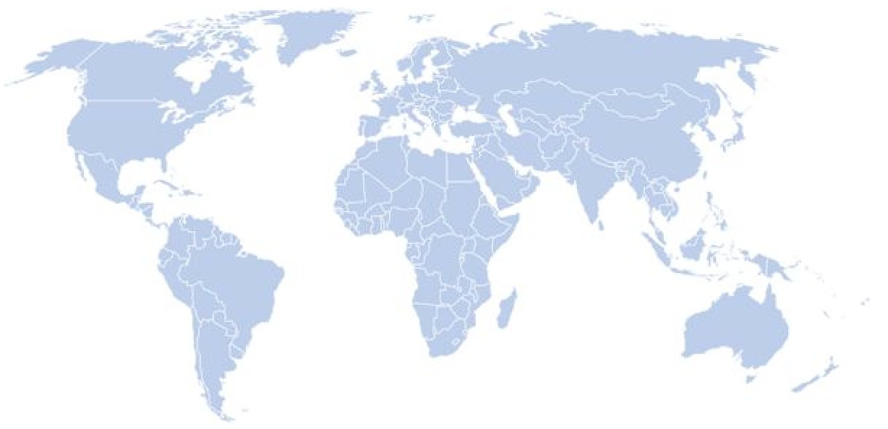

Precision Distribution
Safety Reference Model
Unburdened Resources
Quality Oversight
Notes:
What did we build in order to overcome these challenges?
A rules-based Artificial Intelligence that uses an evolving safety reference model of regulatory Intelligence from 125+ countries to power precision distribution to sites, EC and RAs in those countries.
The AI considers causality, blinding and unblinding, RSI, cross reporting, country rules, local site and EC rules when making its distribution decisions.
Inspection Readiness and traceability were at the core of the design – always distribute to local laws and alert those responsible in real time if there is a transmission failure and a risk of sites/ECs not getting timely information.

Slide 26
“System is seriously phenomenal compared to other sponsor’s pharmacovigilance systems”
Notes:
PI at Columbia University

Slide 27

Reduction in Site Burden
Notes:
Average reduction in Safety Reports = 5
2 hours per Safety Report
Measured over 30k sites

Slide 28
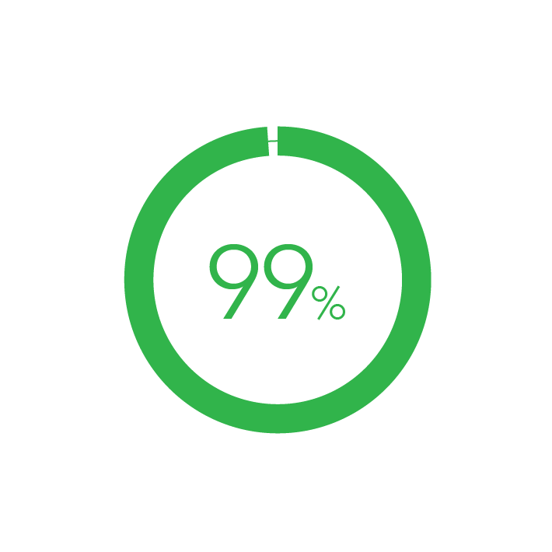
Sites in Compliance
Notes:
Trained active users accessing system and receiving delivery.

Slide 29
Costs Avoided
175 - 450k per trial
Notes:
Figures measured from over 2000 trials. 175k vs basic technology and 450k vs manual distribution.

Slide 30
Improve Patient Safety
Make Sites Happier
Pass Inspections
Avoid Costs
Notes:
By eliminating over-distribution of safety reports, you will transform your clinical operations, improve patient safety, reduce site burden, improve compliance, and save money.

Slide 31

Notes:
Change is never painful, only resistance to change is painful. Join us in building the safety reporting reference model. May all your future safety reporting be accurate and precise.

Slide 32


Slide 33

Steven Beales
SVP, Safety Solutions, WCG
sbeales@wcgclinical.com
610-834-6209

